Slide 1


Slide 2
CHAPTER 3
Data Modeling Using the Entity-Relationship (ER) Model

Slide 3
Chapter Outline
Overview of Database Design Process
Example Database Application (COMPANY)
ER Model Concepts
Entities and Attributes
Entity Types, Value Sets, and Key Attributes
Relationships and Relationship Types
Weak Entity Types
Roles and Attributes in Relationship Types
ER Diagrams - Notation
ER Diagram for COMPANY Schema
Alternative Notations – UML class diagrams, others
Relationships of Higher Degree

Slide 4
Overview of Database Design Process
Two main activities:
Database design
Applications design
Focus in this chapter on conceptual database design
To design the conceptual schema for a database application
Applications design focuses on the programs and interfaces that access the database
Generally considered part of software engineering

Slide 5
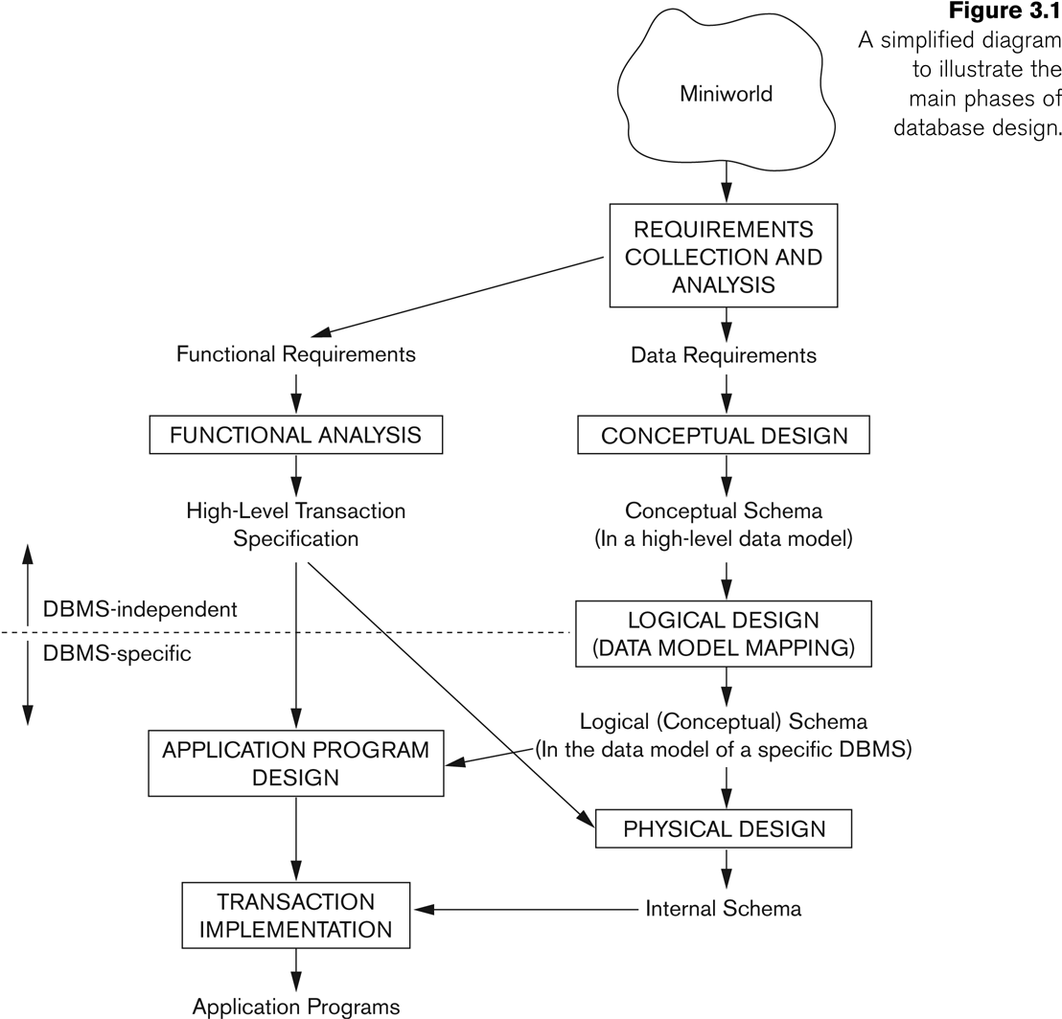
Overview of Database Design Process

Slide 6
Functional Requirements
Functional requirements define the specific features, capabilities, and operations that a system, software, or application must perform. These requirements focus on what the system should do to meet business and user needs.
ID | Requirement | Priority
FR-001 | Users must be able to register an account. | High
FR-002 | Users must be able to reset passwords. | Medium
FR-003 | Admin must be able to manage product inventory. | High
FR-004 | System must generate order invoices. | High
Feature | Functional Requirements | Non-Functional Requirements
Focus | What the system should do | How the system should perform
Example | “Users can search for products” | “Search results must load in under 2 seconds”
Type | Features & system behavior | Performance, security, reliability
Validation | Tested via functional testing | Tested via performance & security testing

Slide 7
Conceptual Design
Once the requirements have been collected and analyzed, the next step is to create a conceptual schema for the database, using a high-level conceptual data model.
Because these concepts do not include implementation details, they are usually easier to understand and can be used to communicate with nontechnical users.
Data storage details are not considered here. This helps the designer to concentrate on the real problem.

Slide 8
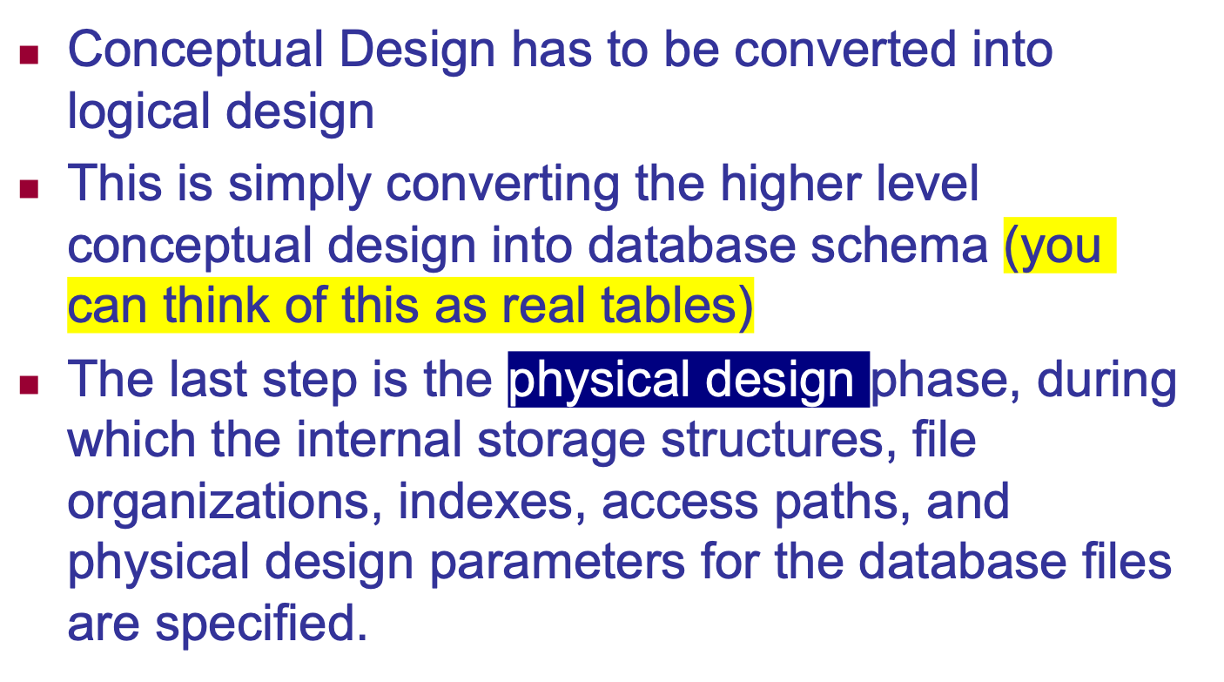
Logical Design or Data Model Mapping

Slide 9
Methodologies for Conceptual Design
Entity Relationship (ER) Diagrams (This Chapter)
Enhanced Entity Relationship (EER) Diagrams (Chapter 4)
Use of Design Tools in industry for designing and documenting large scale designs
The UML (Unified Modeling Language) Class Diagrams are popular in industry to document conceptual database designs

Slide 10
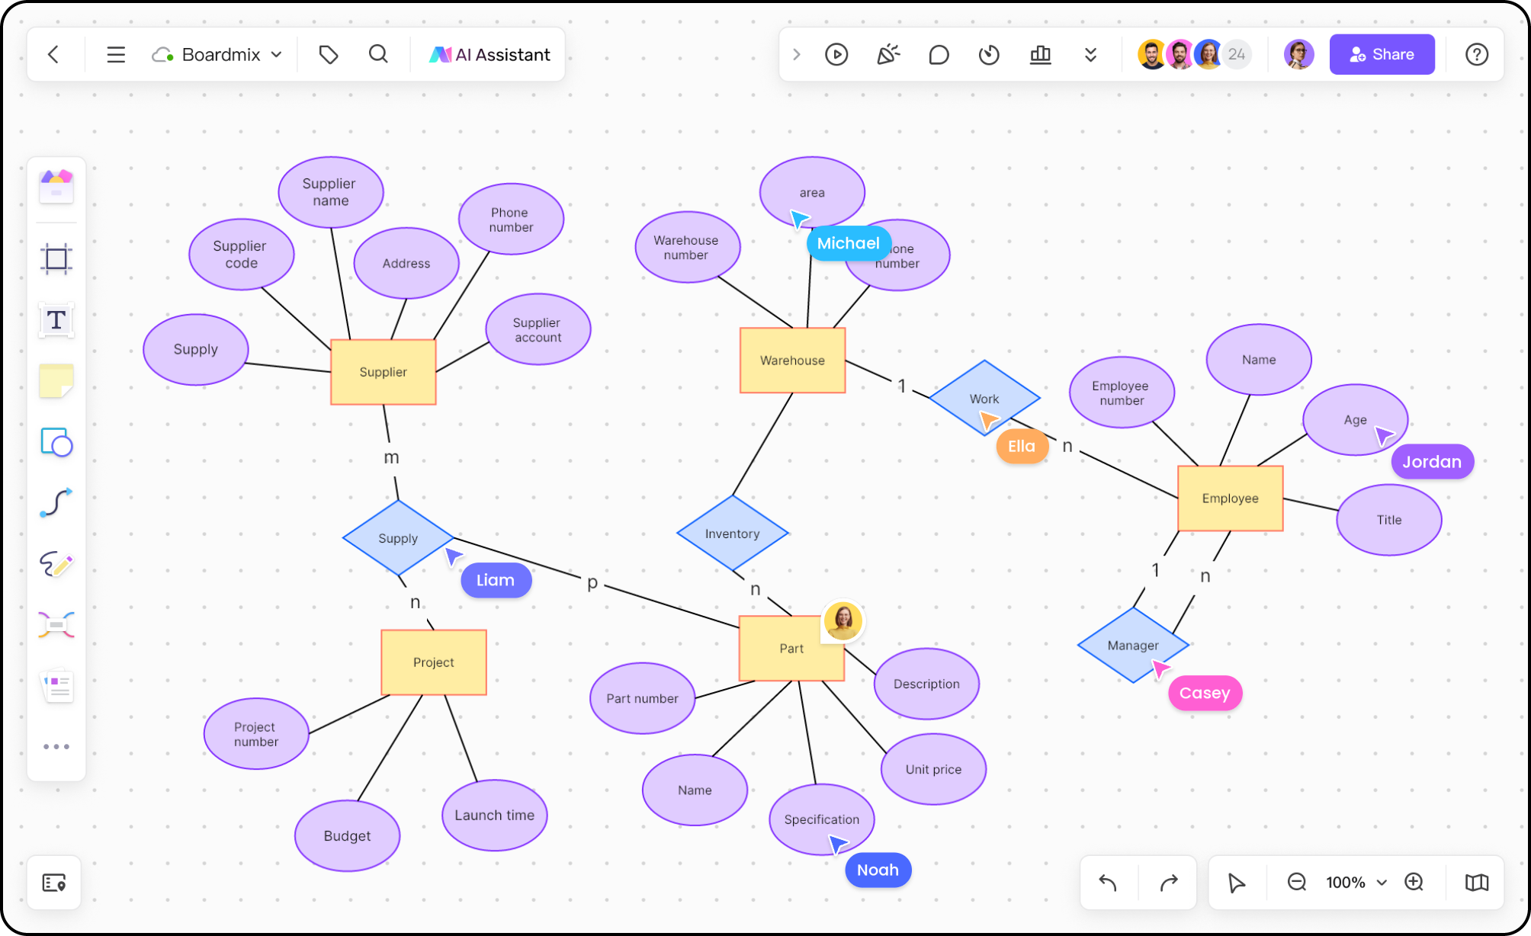
ER Digram Tools – An Example

Slide 11
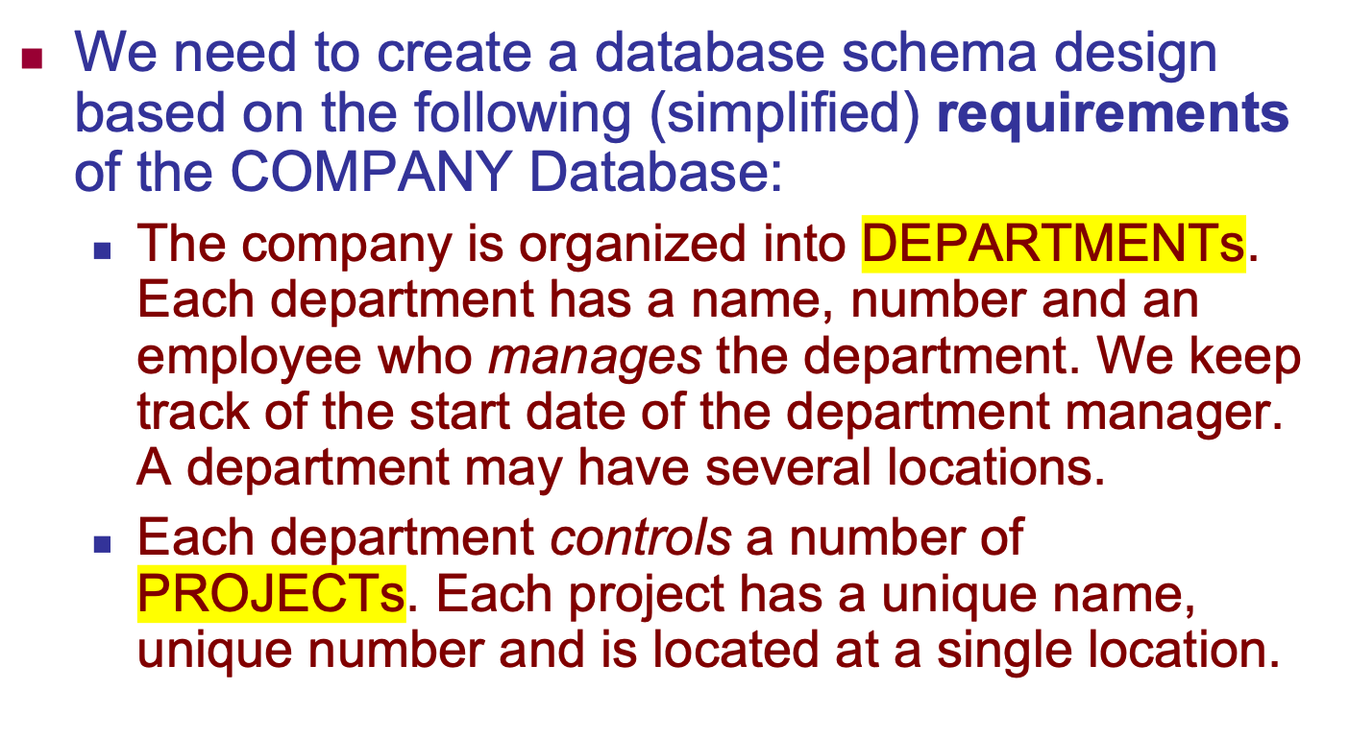
Example COMPANY Database

Slide 12
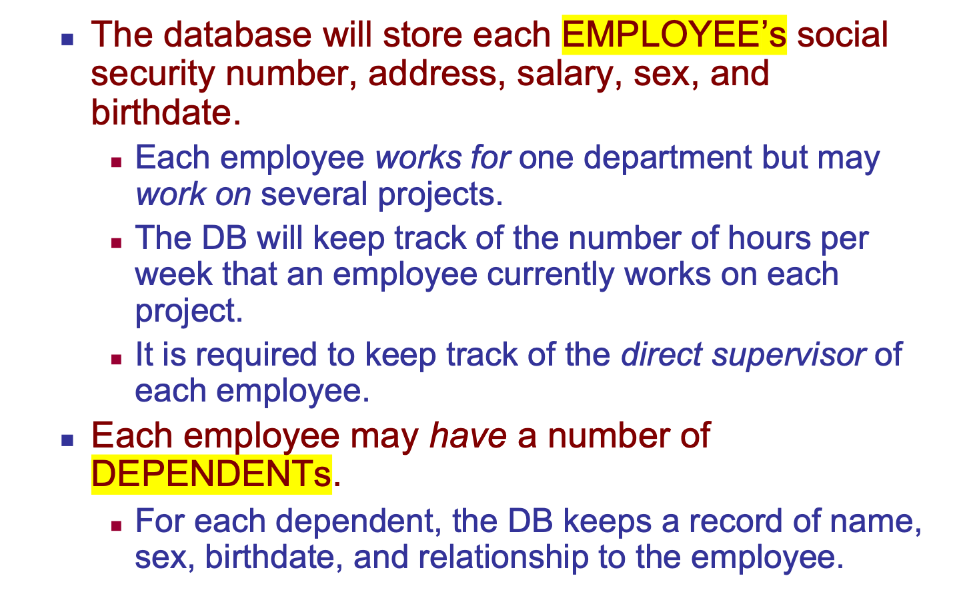
Example COMPANY Database (Continued)

Slide 13
ER Model Concepts
Entities and Attributes
Entity is a basic concept for the ER model. Entities are specific things or objects in the mini-world that are represented in the database.
For example the EMPLOYEE John Smith, the Research DEPARTMENT, the ProductX PROJECT
Attributes are properties used to describe an entity.
For example an EMPLOYEE entity may have the attributes Name, SSN, Address, Sex, BirthDate
A specific entity will have a value for each of its attributes.
For example a specific employee entity may have Name='John Smith', SSN='123456789', Address ='731, Fondren, Houston, TX', Sex='M', BirthDate='09-JAN-55‘
Each attribute has a value set (or data type) associated with it – e.g. integer, string, date, enumerated type, …

Slide 14
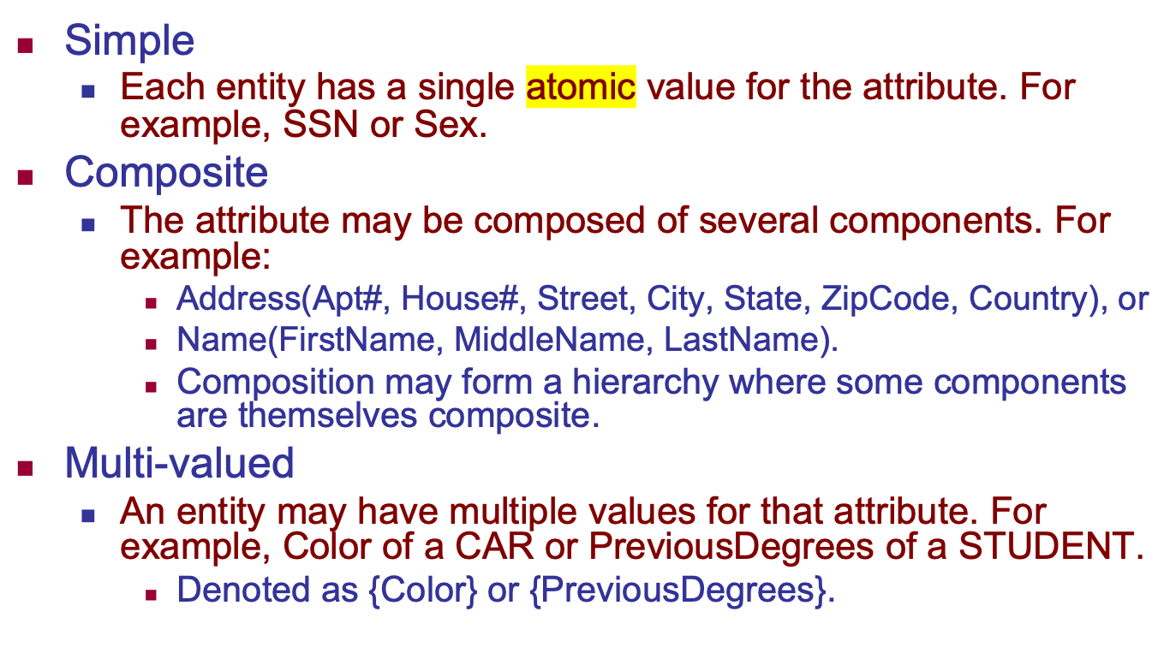
Types of Attributes (1)

Slide 15
Types of Attributes (2)
In general, composite and multi-valued attributes may be nested arbitrarily to any number of levels, although this is rare.
For example, PreviousDegrees of a STUDENT is a composite multi-valued attribute denoted by {PreviousDegrees (College, Year, Degree, Field)}
Multiple PreviousDegrees values can exist
Each has four subcomponent attributes:
College, Year, Degree, Field

Slide 16
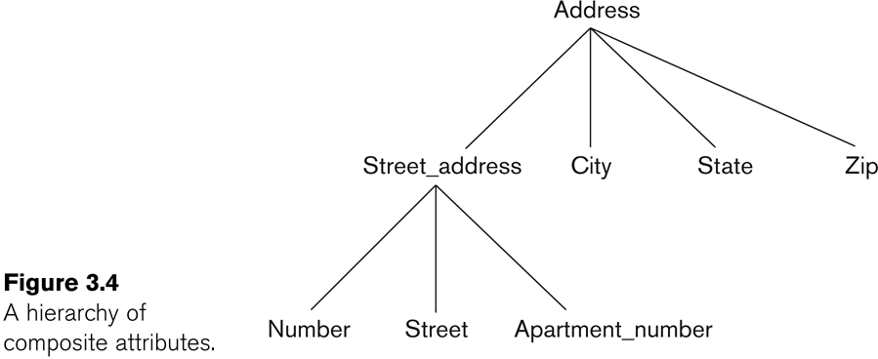
Example of a composite attribute

Slide 17
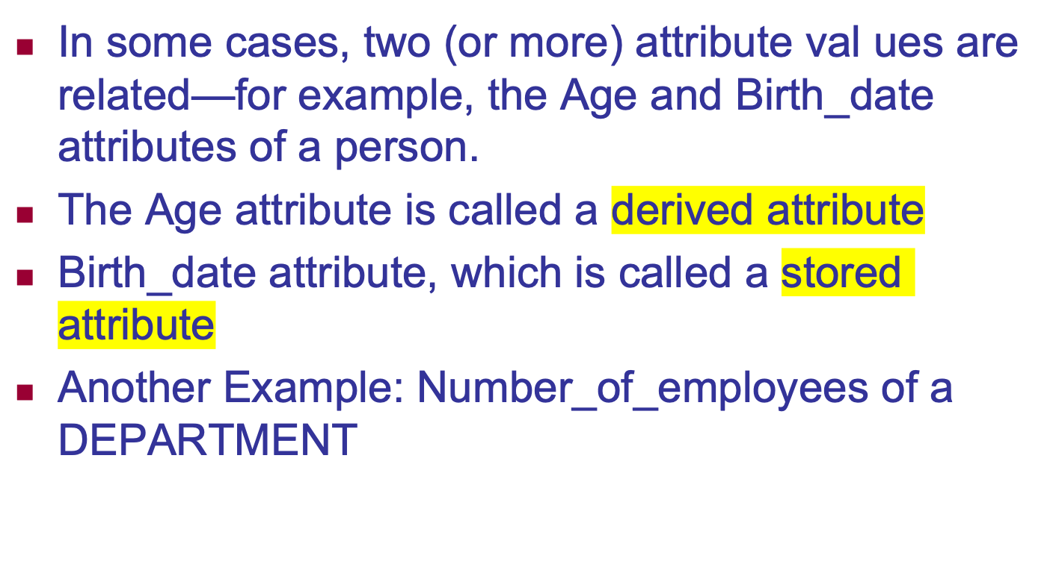
Stored versus Derived Attributes.

Slide 18
Entity Types and Key Attributes (1)
Entities with the same basic attributes are grouped or typed into an entity type.
For example, the entity type EMPLOYEE and PROJECT.
An attribute of an entity type for which each entity must have a unique value is called a key attribute of the entity type.
For example, SSN of EMPLOYEE.

Slide 19
Entity Types and Key Attributes (2)
A key attribute may be composite.
VehicleTagNumber is a key of the CAR entity type with components (Number, State).
An entity type may have more than one key.
The CAR entity type may have two keys:
VehicleIdentificationNumber (popularly called VIN)
VehicleTagNumber (Number, State), aka license plate number.
Each key is underlined (Note: this is different from the relational schema where only one “primary key is underlined).

Slide 20
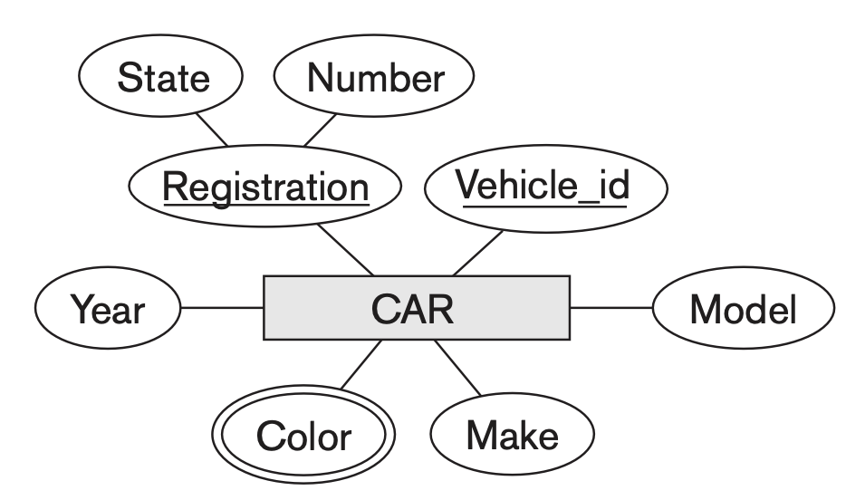
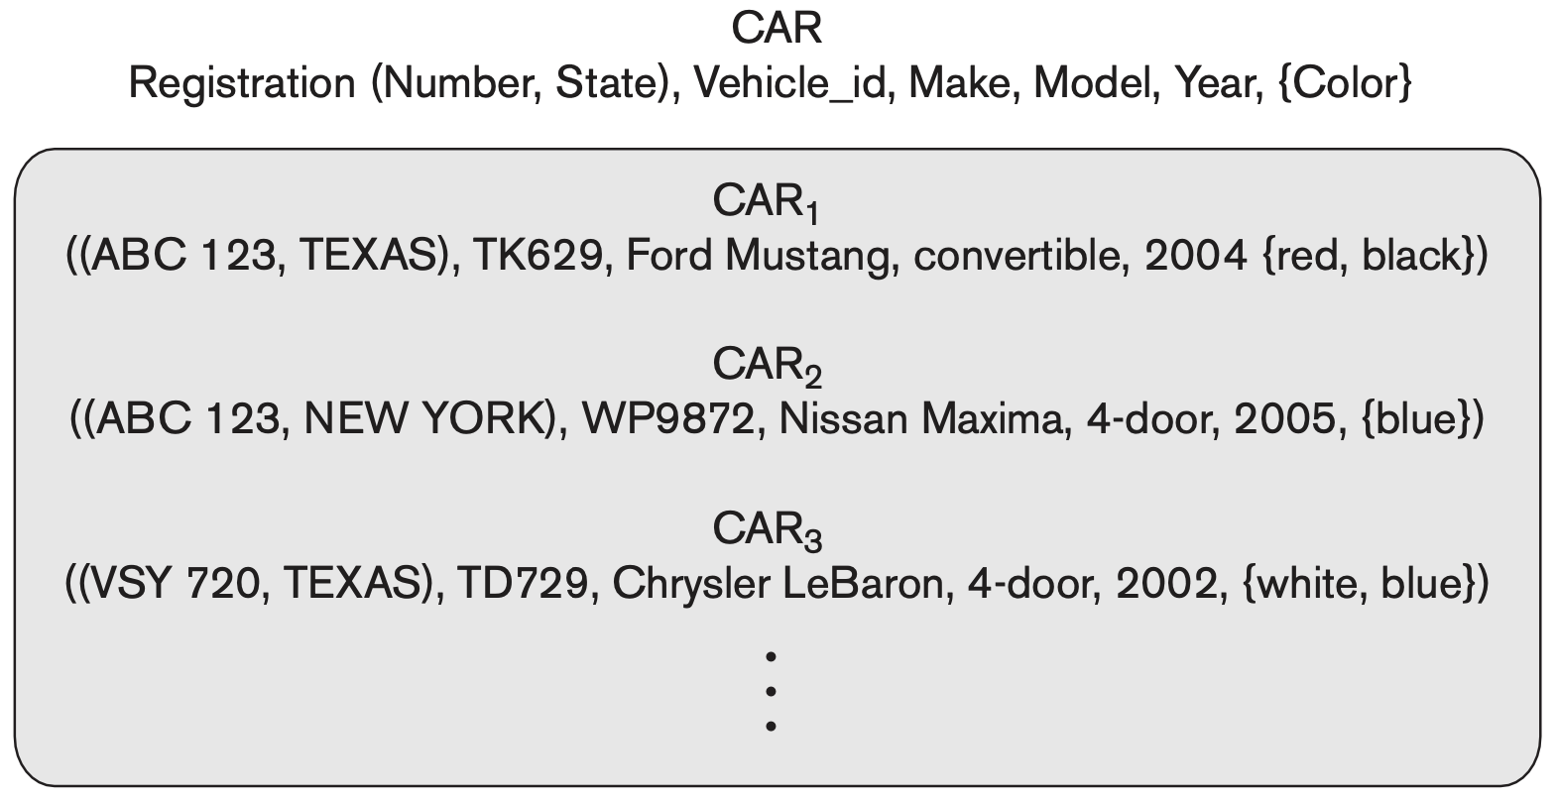
Entitiy Type and Entity Set

Slide 21
Entity Set
Each entity type will have a collection of entities stored in the database
Called the entity set or sometimes entity collection
Previous slide shows three CAR entity instances in the entity set for CAR
Same name (CAR) used to refer to both the entity type and the entity set
However, entity type and entity set may be given different names
Entity set is the current state of the entities of that type that are stored in the database

Slide 22
Value Sets (Domains) of Attributes
Each simple attribute is associated with a value set
E.g., Lastname has a value which is a character string of upto 15 characters, say
Date has a value consisting of MM-DD-YYYY where each letter is an integer
Range of ages allowed for employees is between 16 and 70,
A value set specifies the set of values associated with an attribute

Slide 23
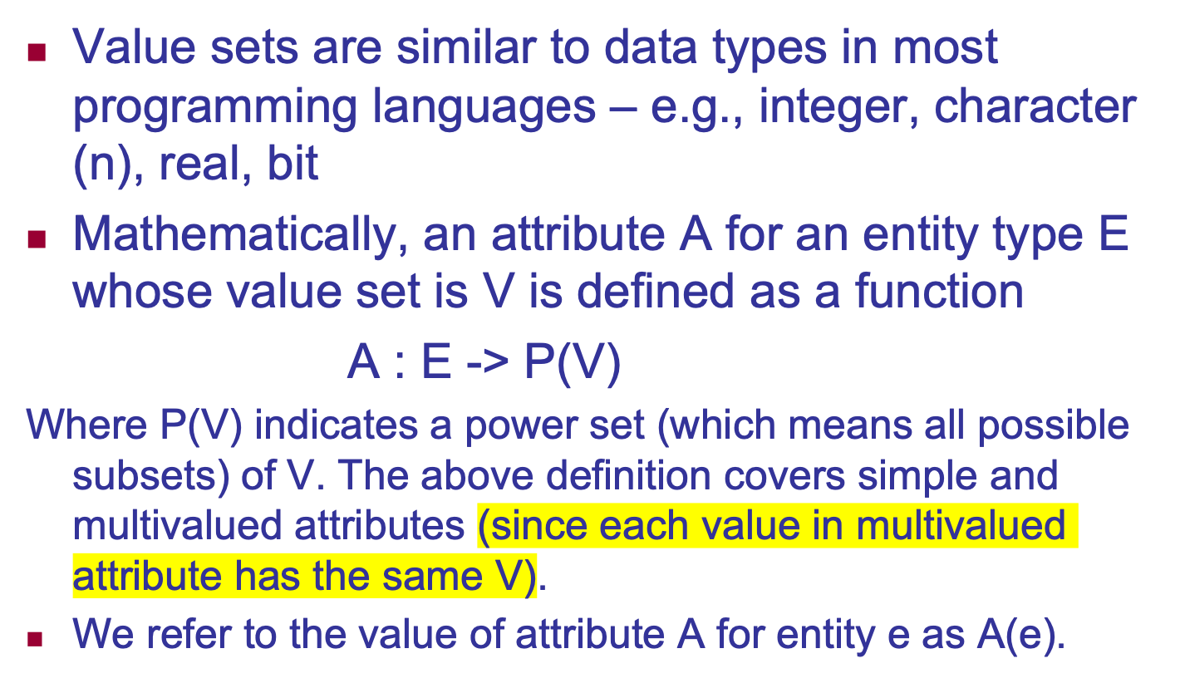
Attributes and Value Sets

Slide 24
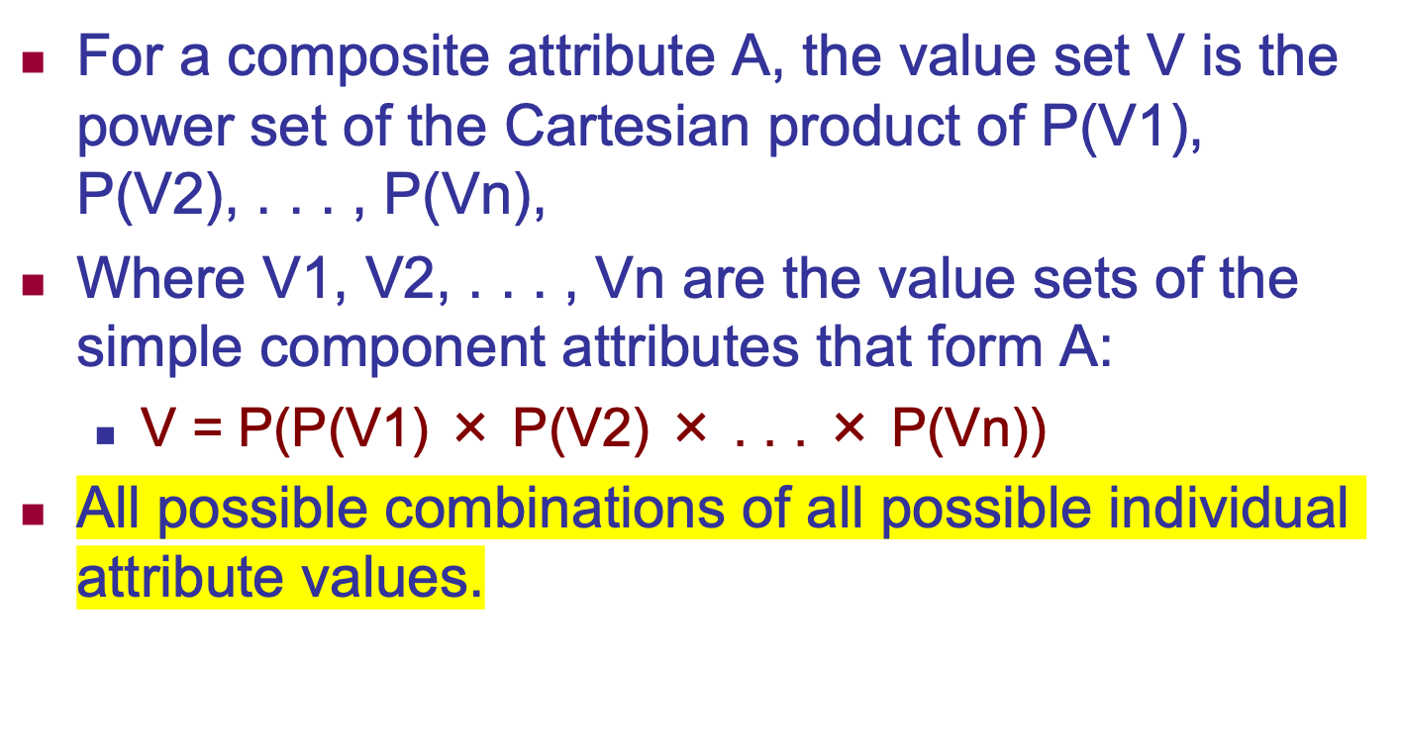
Composite Attributes

Slide 25
Displaying an Entity type
In ER diagrams, an entity type is displayed in a rectangular box
Attributes are displayed in ovals
Each attribute is connected to its entity type
Components of a composite attribute are connected to the oval representing the composite attribute
Each key attribute is underlined
Multivalued attributes displayed in double ovals
See the full ER notation in advance on the next slide

Slide 26
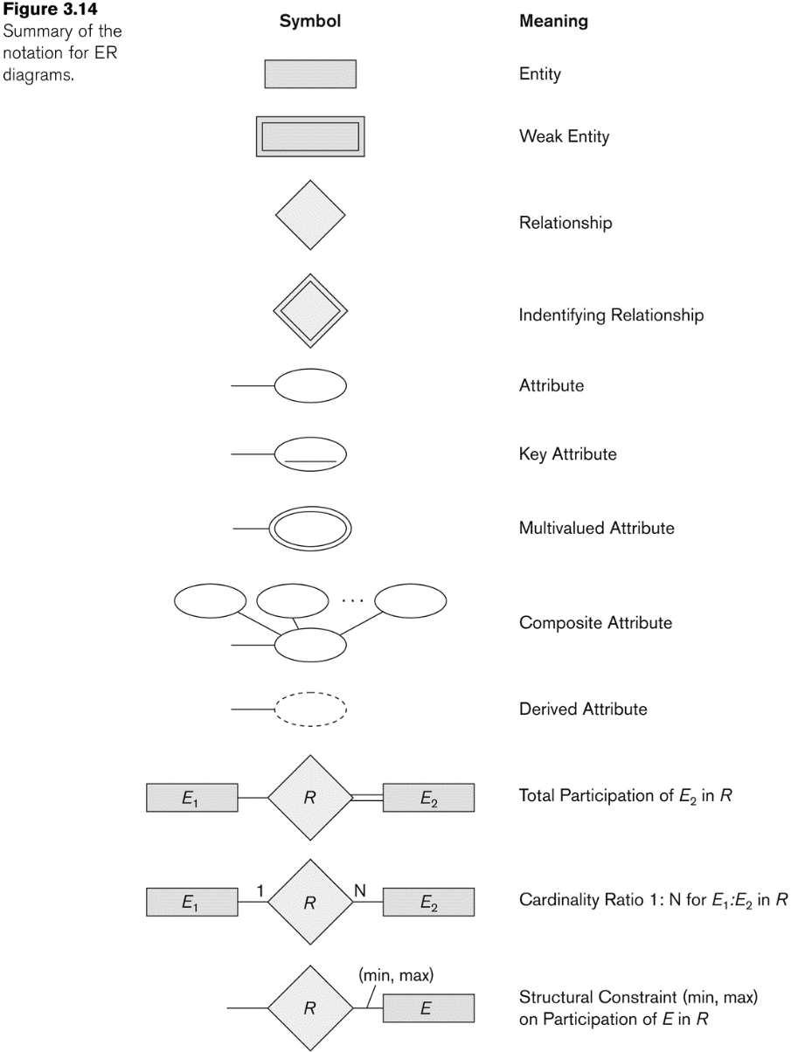
NOTATION for ER diagrams

Slide 27
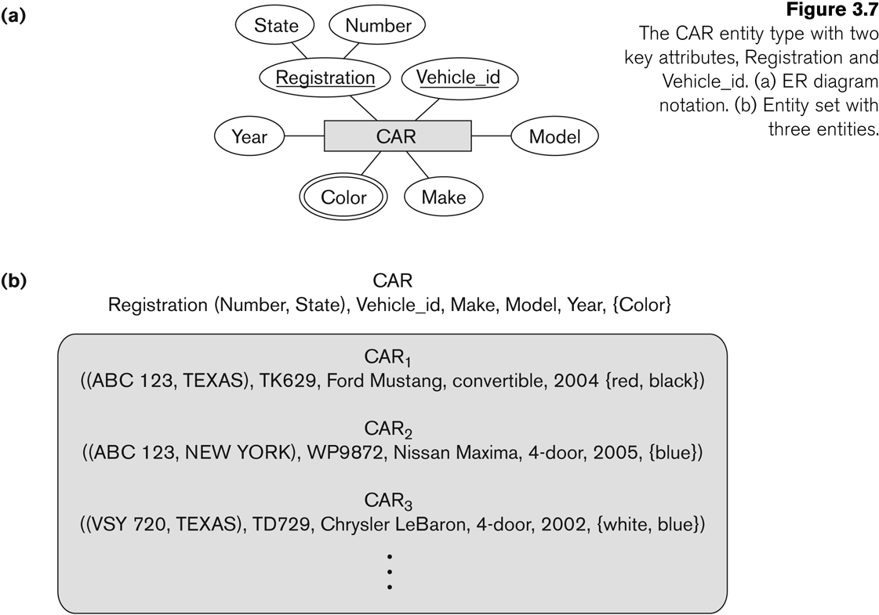
Entity Type CAR with two keys and a corresponding Entity Set

Slide 28
Initial Conceptual Design of Entity Types for the COMPANY Database Schema
Based on the requirements, we can identify four initial entity types in the COMPANY database:
DEPARTMENT
PROJECT
EMPLOYEE
DEPENDENT
Their initial conceptual design is shown on the following slide
The initial attributes shown are derived from the requirements description

Slide 29
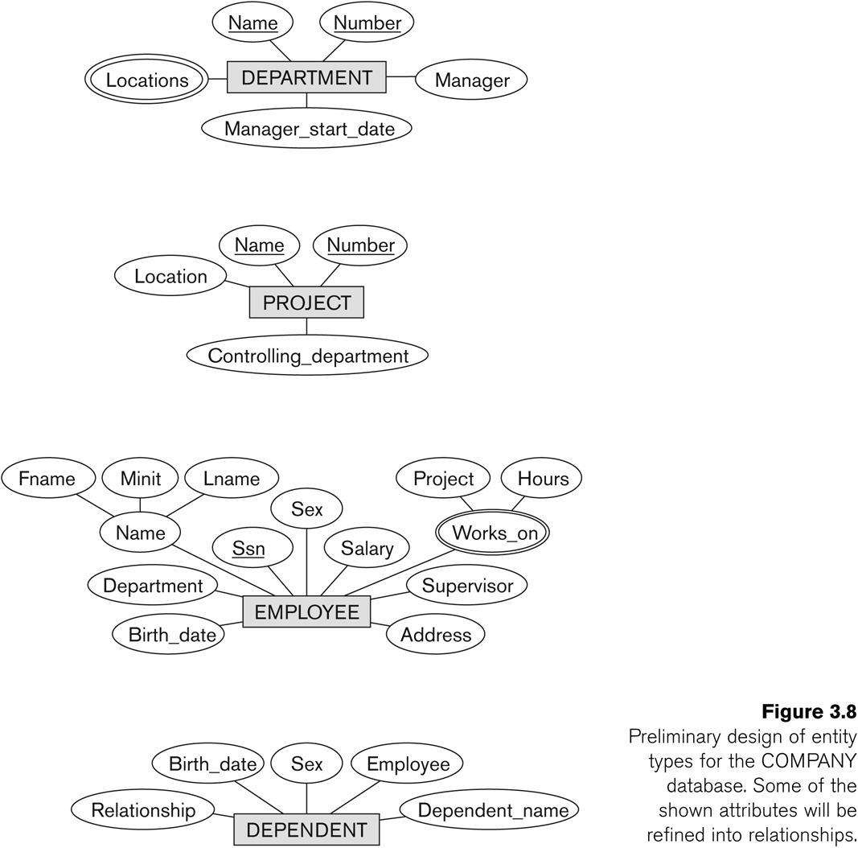
Initial Design of Entity Types: EMPLOYEE, DEPARTMENT, PROJECT, DEPENDENT

Slide 30
Refining the initial design by introducing relationships
The initial design is typically not complete
Some aspects in the requirements will be represented as relationships
ER model has three main concepts:
Entities (and their entity types and entity sets)
Attributes (simple, composite, multivalued)
Relationships (and their relationship types and relationship sets)
We introduce relationship concepts next

Slide 31
Relationships and Relationship Types (1)
A relationship relates two or more distinct entities with a specific meaning.
For example, EMPLOYEE John Smith works on the ProductX PROJECT, or EMPLOYEE Franklin Wong manages the Research DEPARTMENT.
Relationships of the same type are grouped or typed into a relationship type.
For example, the WORKS_ON relationship type in which EMPLOYEEs and PROJECTs participate, or the MANAGES relationship type in which EMPLOYEEs and DEPARTMENTs participate.
The degree of a relationship type is the number of participating entity types.
Both MANAGES and WORKS_ON are binary relationships.

Slide 32
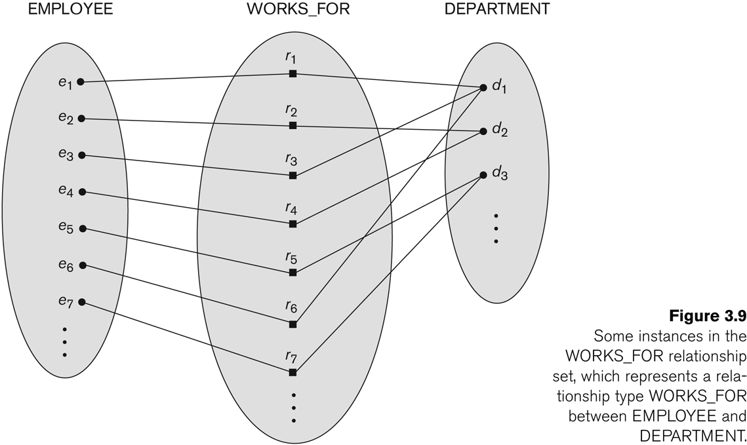
Relationship instances of the WORKS_FOR N:1 relationship between EMPLOYEE and DEPARTMENT

Slide 33
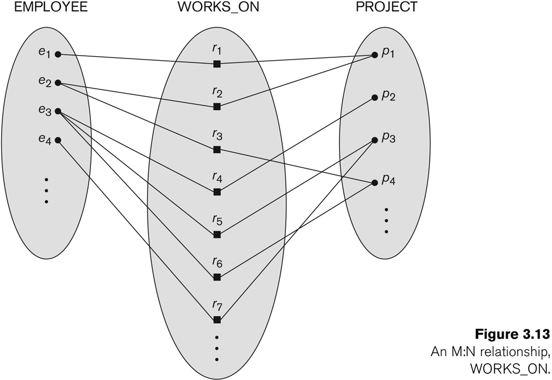
Relationship instances of the M:N WORKS_ON relationship between EMPLOYEE and PROJECT

Slide 34
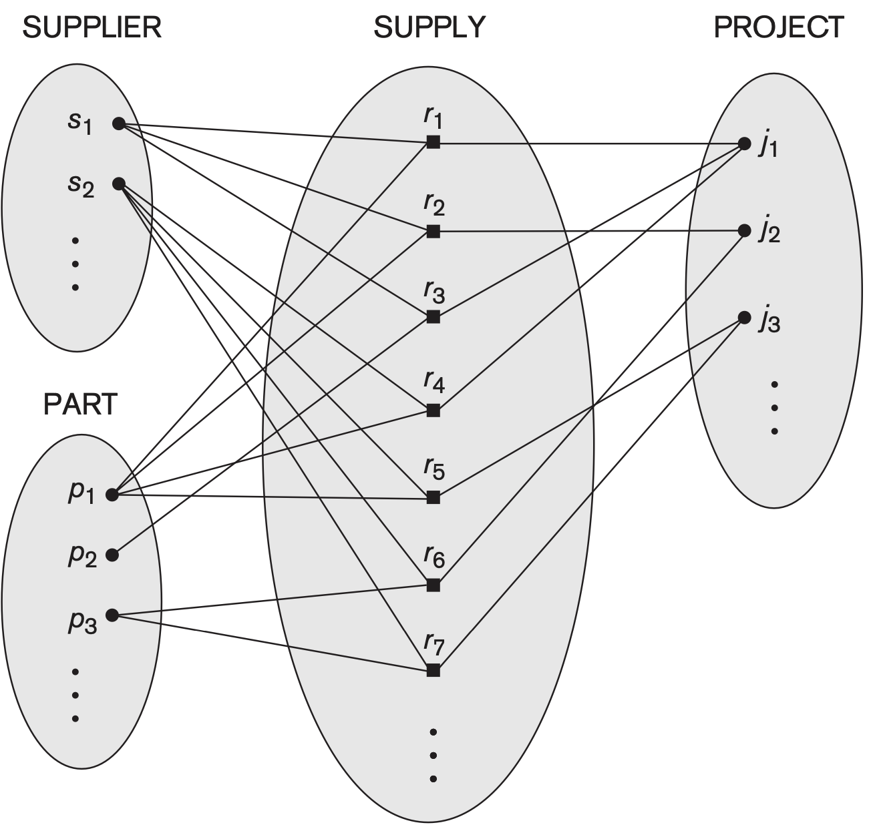
N-ary Relationship

Slide 35
Relationship type vs. relationship set (1)
Relationship Type:
Is the schema description of a relationship
Identifies the relationship name and the participating entity types
Also identifies certain relationship constraints
Relationship Set:
The current set of relationship instances represented in the database
The current state of a relationship type

Slide 36
Relationship type vs. relationship set (2)
Previous figures displayed the relationship sets
Each instance in the set relates individual participating entities – one from each participating entity type
In ER diagrams, we represent the relationship type as follows:
Diamond-shaped box is used to display a relationship type
Connected to the participating entity types via straight lines
Note that the relationship type is not shown with an arrow. The name should be typically be readable from left to right and top to bottom.

Slide 37
Refining the COMPANY database schema by introducing relationships
By examining the requirements, six relationship types are identified
All are binary relationships( degree 2)
Listed below with their participating entity types:
WORKS_FOR (between EMPLOYEE, DEPARTMENT)
MANAGES (also between EMPLOYEE, DEPARTMENT)
CONTROLS (between DEPARTMENT, PROJECT)
WORKS_ON (between EMPLOYEE, PROJECT)
SUPERVISION (between EMPLOYEE (as subordinate), EMPLOYEE (as supervisor))
DEPENDENTS_OF (between EMPLOYEE, DEPENDENT)

Slide 38
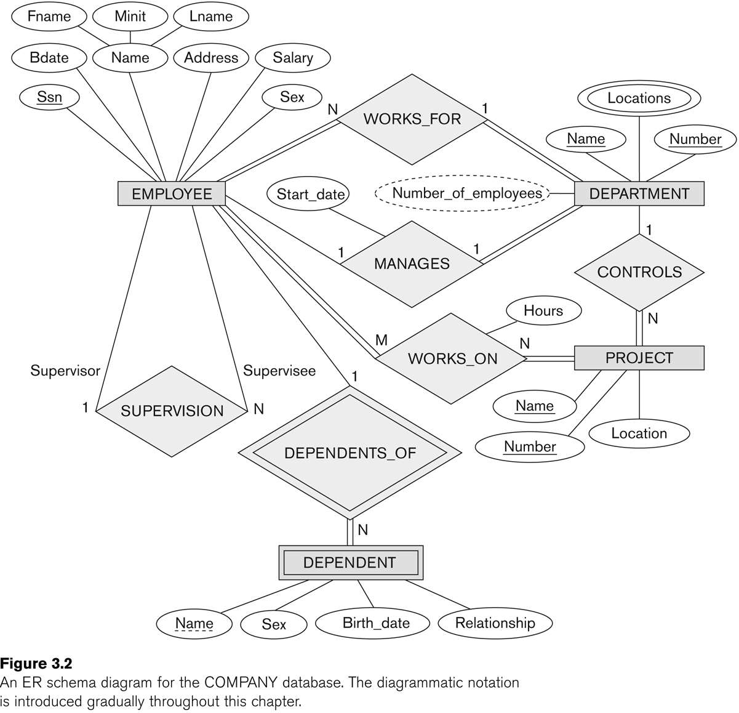
ER DIAGRAM – Relationship Types are: WORKS_FOR, MANAGES, WORKS_ON, CONTROLS, SUPERVISION, DEPENDENTS_OF

Slide 39
Discussion on Relationship Types
In the refined design, some attributes from the initial entity types are refined into relationships:
Manager of DEPARTMENT -> MANAGES
Works_on of EMPLOYEE -> WORKS_ON
Department of EMPLOYEE -> WORKS_FOR
etc
In general, more than one relationship type can exist between the same participating entity types
MANAGES and WORKS_FOR are distinct relationship types between EMPLOYEE and DEPARTMENT
Different meanings and different relationship instances.

Slide 40
Constraints on Relationships
Constraints on Relationship Types
(Also known as ratio constraints)
Cardinality Ratio (specifies maximum participation)
One-to-one (1:1)
One-to-many (1:N) or Many-to-one (N:1)
Many-to-many (M:N)
Existence Dependency Constraint (specifies minimum participation) (also called participation constraint)
zero (optional participation, not existence-dependent)
one or more (mandatory participation, existence-dependent)

Slide 41
Many-to-one (N:1) Relationship

Slide 42
Many-to-many (M:N) Relationship

Slide 43
Recursive Relationship Type
A relationship type between the same participating entity type in distinct roles
Also called a self-referencing relationship type.
Example: the SUPERVISION relationship
EMPLOYEE participates twice in two distinct roles:
supervisor (or boss) role
supervisee (or subordinate) role
Each relationship instance relates two distinct EMPLOYEE entities:
One employee in supervisor role
One employee in supervisee role

Slide 44
Displaying a recursive relationship
In a recursive relationship type.
Both participations are same entity type in different roles.
For example, SUPERVISION relationships between EMPLOYEE (in role of supervisor or boss) and (another) EMPLOYEE (in role of subordinate or worker).
In following figure, first role participation labeled with 1 and second role participation labeled with 2.
In ER diagram, need to display role names to distinguish participations.

Slide 45
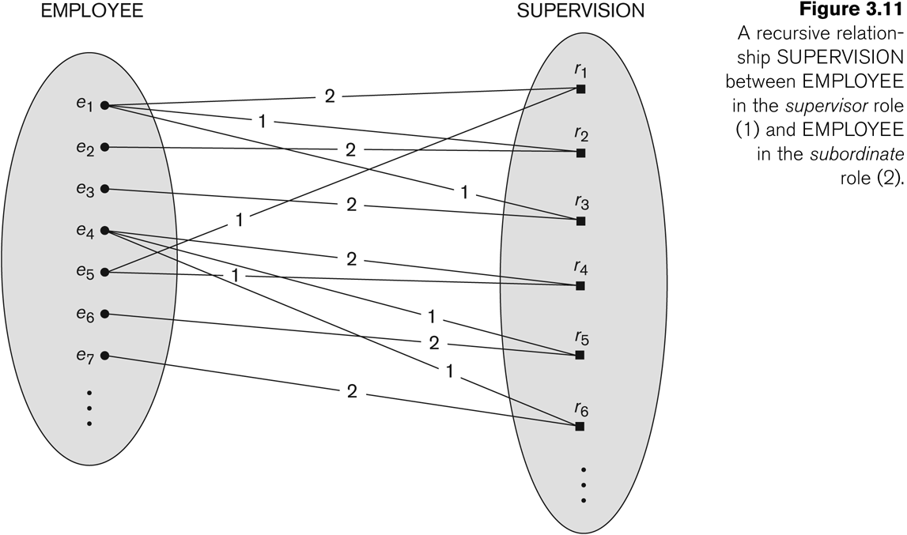
A Recursive Relationship Supervision`

Slide 46
Recursive Relationship Type is: SUPERVISION (participation role names are shown)

Slide 47
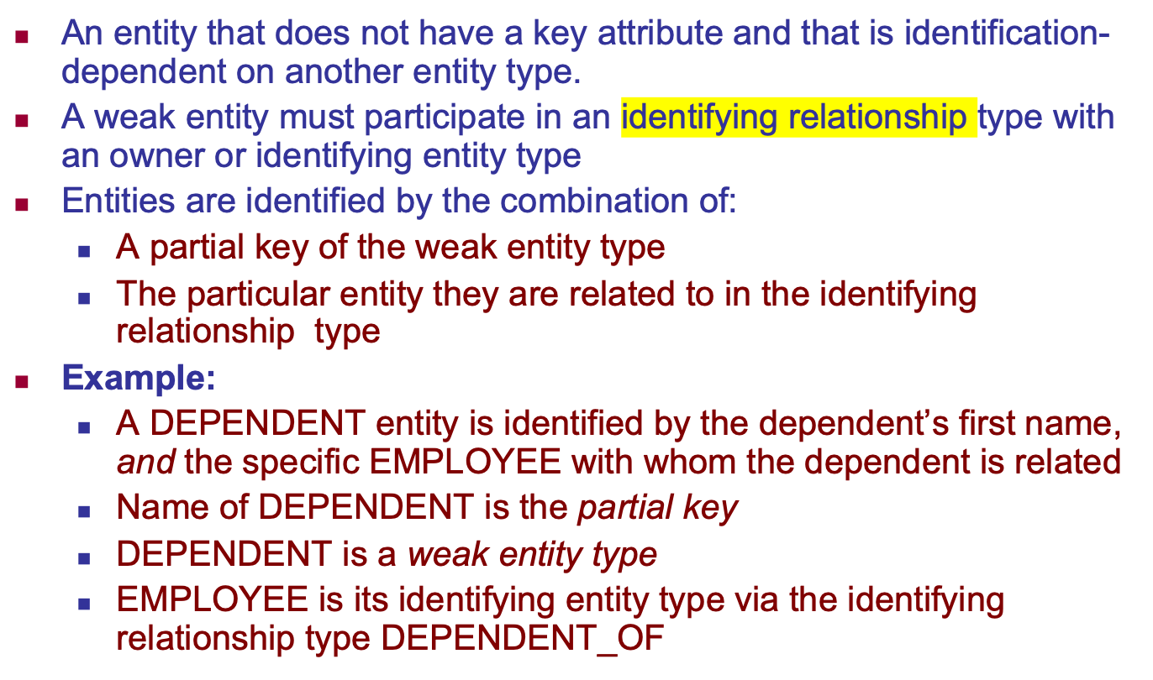
Weak Entity Types

Slide 48
Attributes of Relationship types
A relationship type can have attributes:
For example, HoursPerWeek of WORKS_ON
Its value for each relationship instance describes the number of hours per week that an EMPLOYEE works on a PROJECT.
A value of HoursPerWeek depends on a particular (employee, project) combination
Most relationship attributes are used with M:N relationships
In 1:N relationships, they can be transferred to the entity type on the N-side of the relationship

Slide 49
Example Attribute of a Relationship Type: Hours of WORKS_ON

Slide 50
Notation for Constraints on Relationships
Cardinality ratio (of a binary relationship): 1:1, 1:N, N:1, or M:N
Shown by placing appropriate numbers on the relationship edges.
Participation constraint (on each participating entity type): total (called existence dependency) or partial.
Total shown by double line, partial by single line.
NOTE: These are easy to specify for Binary Relationship Types.

Slide 51
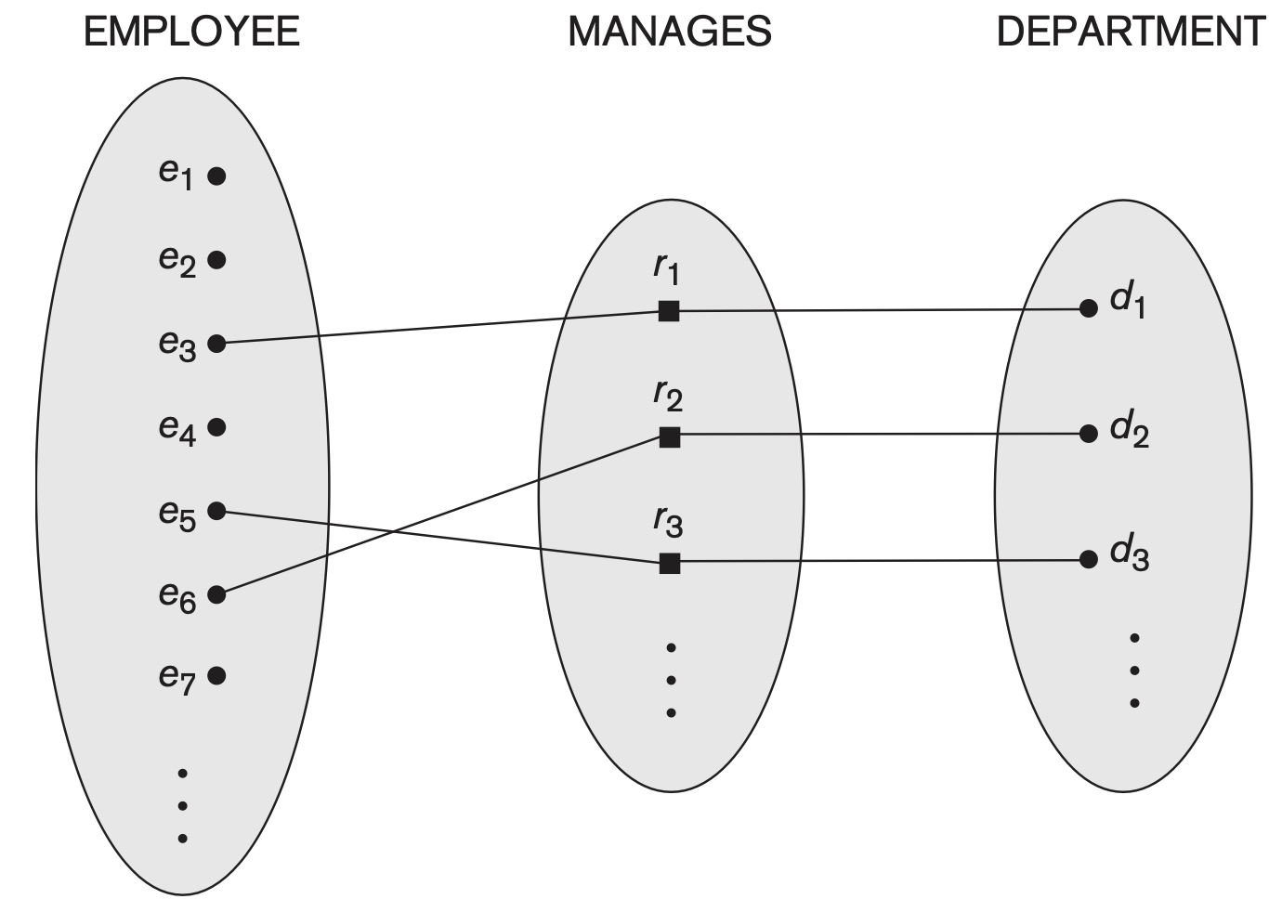
1:1 Relationship

Slide 52
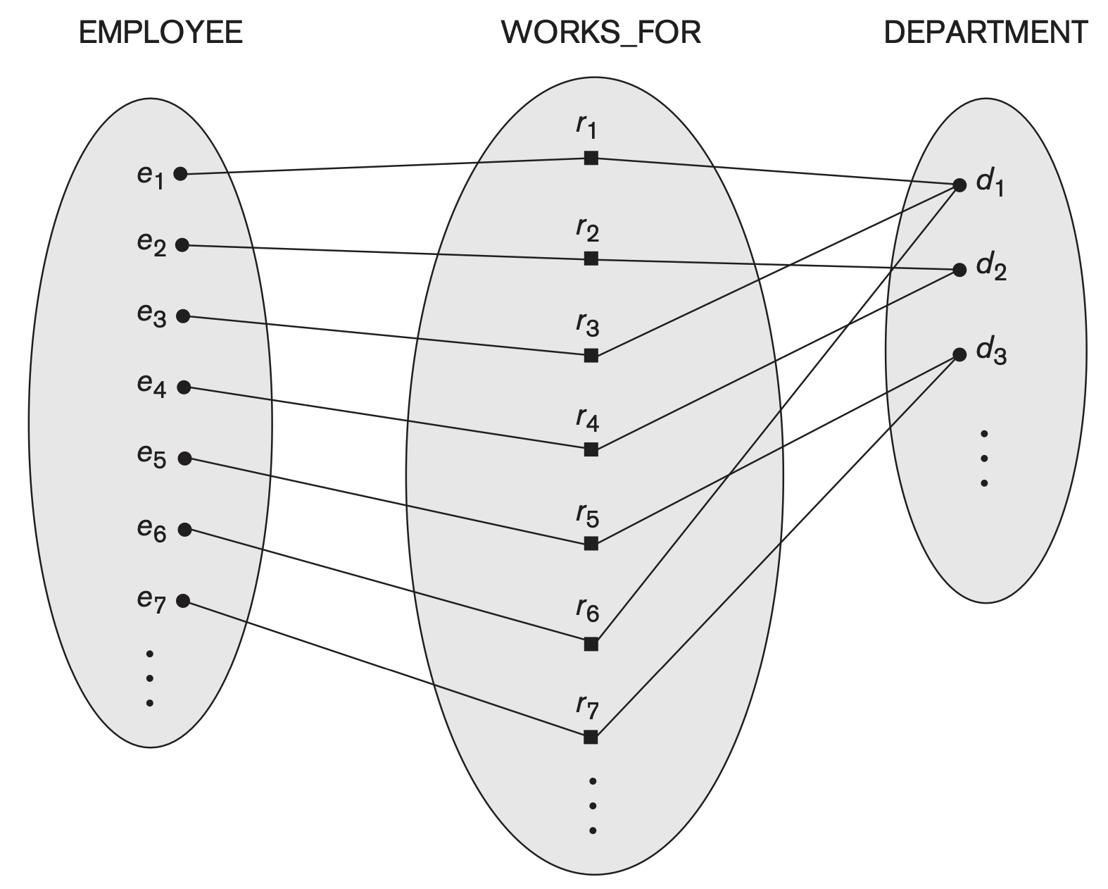
N:1 Relationship

Slide 53
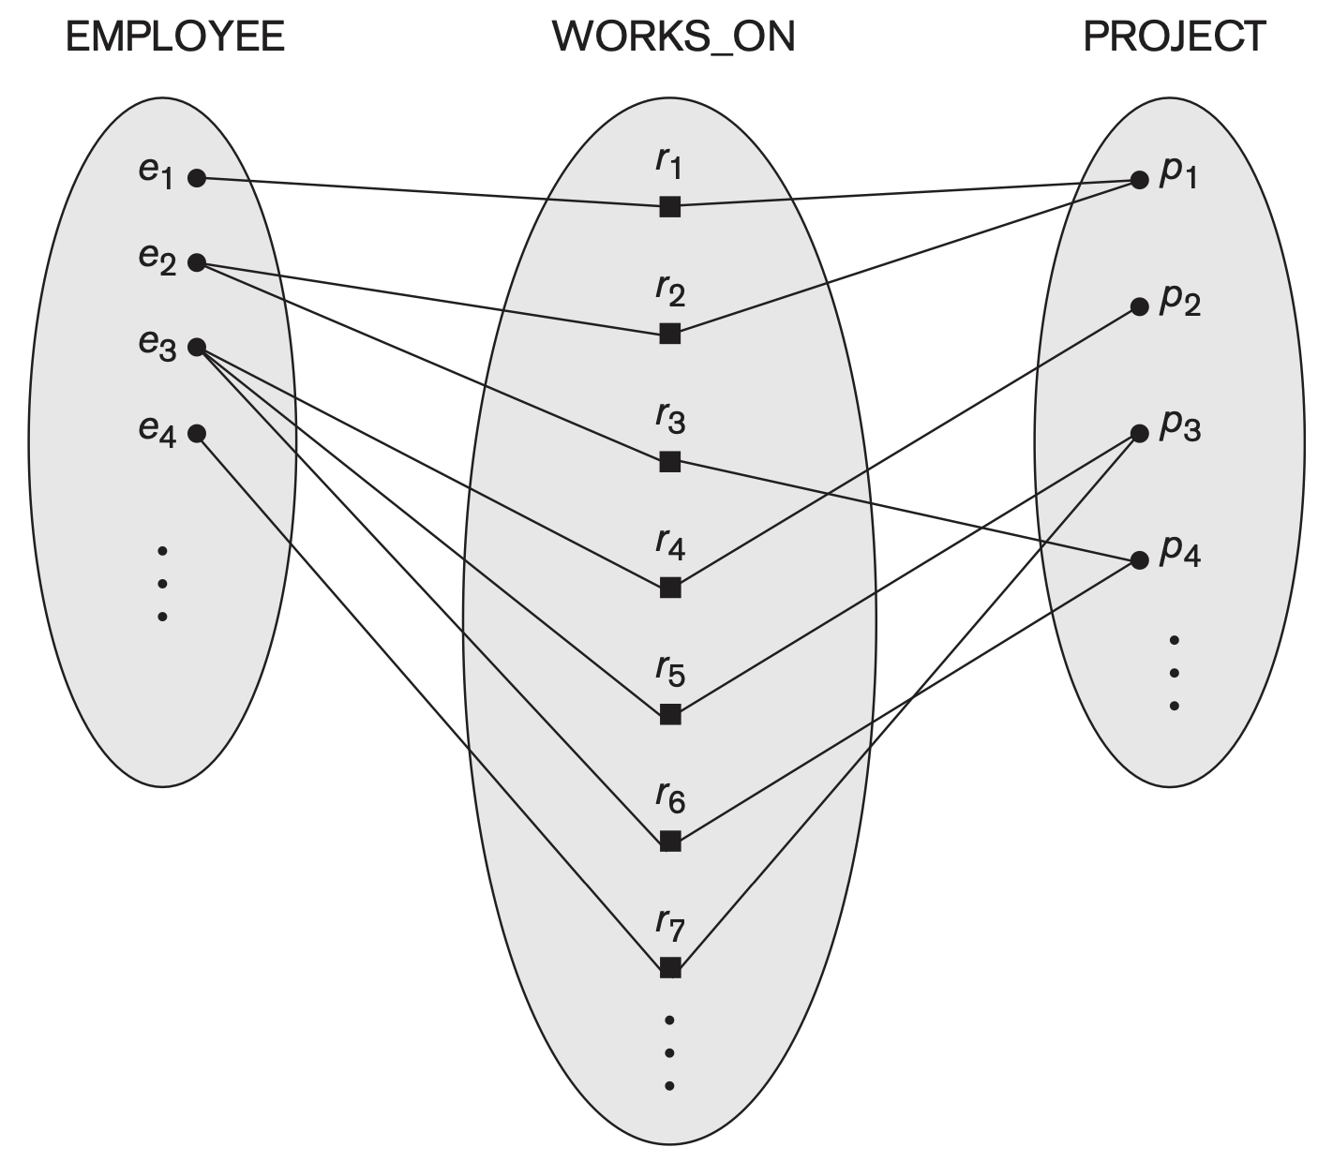
M:N Relationship

Slide 54
Alternative (min, max) notation for relationship structural constraints:
Specified on each participation of an entity type E in a relationship type R
Specifies that each entity e in E participates in at least min and at most max relationship instances in R
Default(no constraint): min=0, max=n (signifying no limit)
Must have min≤max, min≥0, max ≥1
Derived from the knowledge of mini-world constraints
Examples:
A department has exactly one manager and an employee can manage at most one department.
Specify (0,1) for participation of EMPLOYEE in MANAGES
Specify (1,1) for participation of DEPARTMENT in MANAGES
An employee can work for exactly one department but a department can have any number of employees.
Specify (1,1) for participation of EMPLOYEE in WORKS_FOR
Specify (0,n) for participation of DEPARTMENT in WORKS_FOR

Slide 55
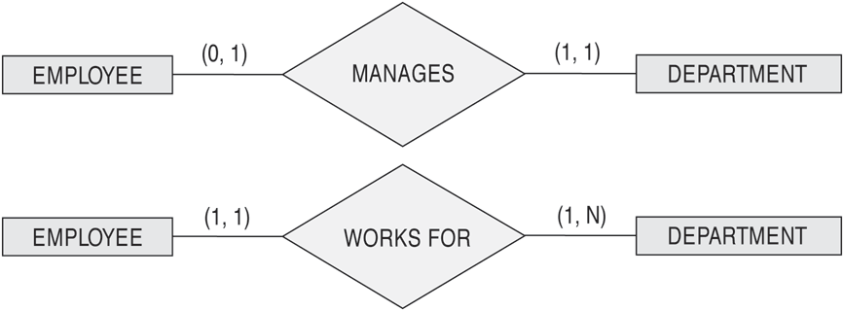
The (min,max) notation for relationship constraints
Read the min,max numbers next to the entity type and looking away from the entity type

Slide 56
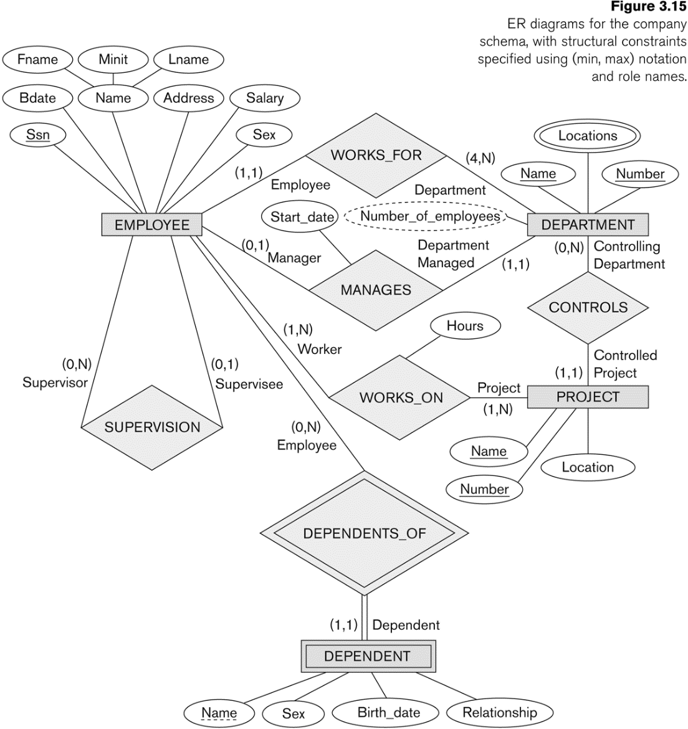
COMPANY ER Schema Diagram using (min, max) notation

Slide 57
Alternative diagrammatic notation
ER diagrams is one popular example for displaying database schemas
Many other notations exist in the literature and in various database design and modeling tools
Appendix A illustrates some of the alternative notations that have been used
UML class diagrams is representative of another way of displaying ER concepts that is used in several commercial design tools

Slide 58
Summary of notation for ER diagrams

Slide 59
UML class diagrams
Represent classes (similar to entity types) as large rounded boxes with three sections:
Top section includes entity type (class) name
Second section includes attributes
Third section includes class operations (operations are not in basic ER model)
Relationships (called associations) represented as lines connecting the classes
Other UML terminology also differs from ER terminology
Used in database design and object-oriented software design
UML has many other types of diagrams for software design

Slide 60
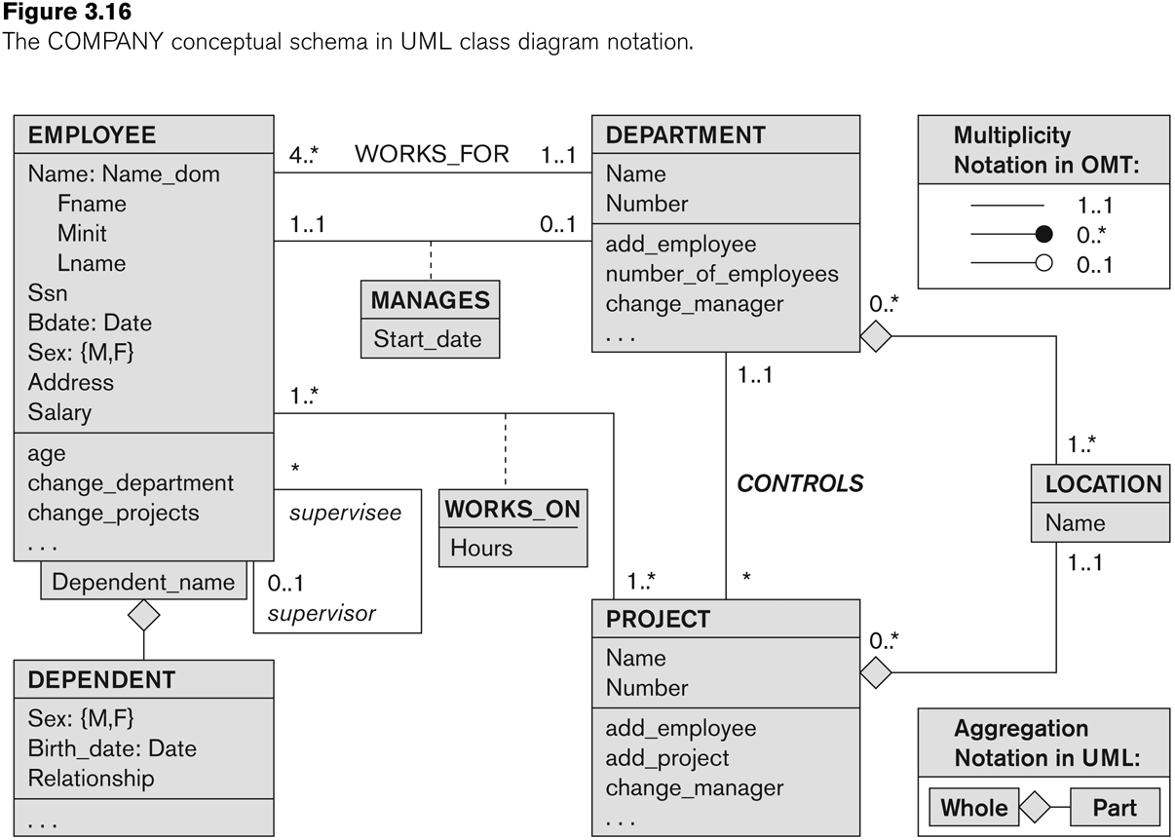
UML class diagram for COMPANY database schema
Association
Aggregation
“whole-part” relationship

Slide 61
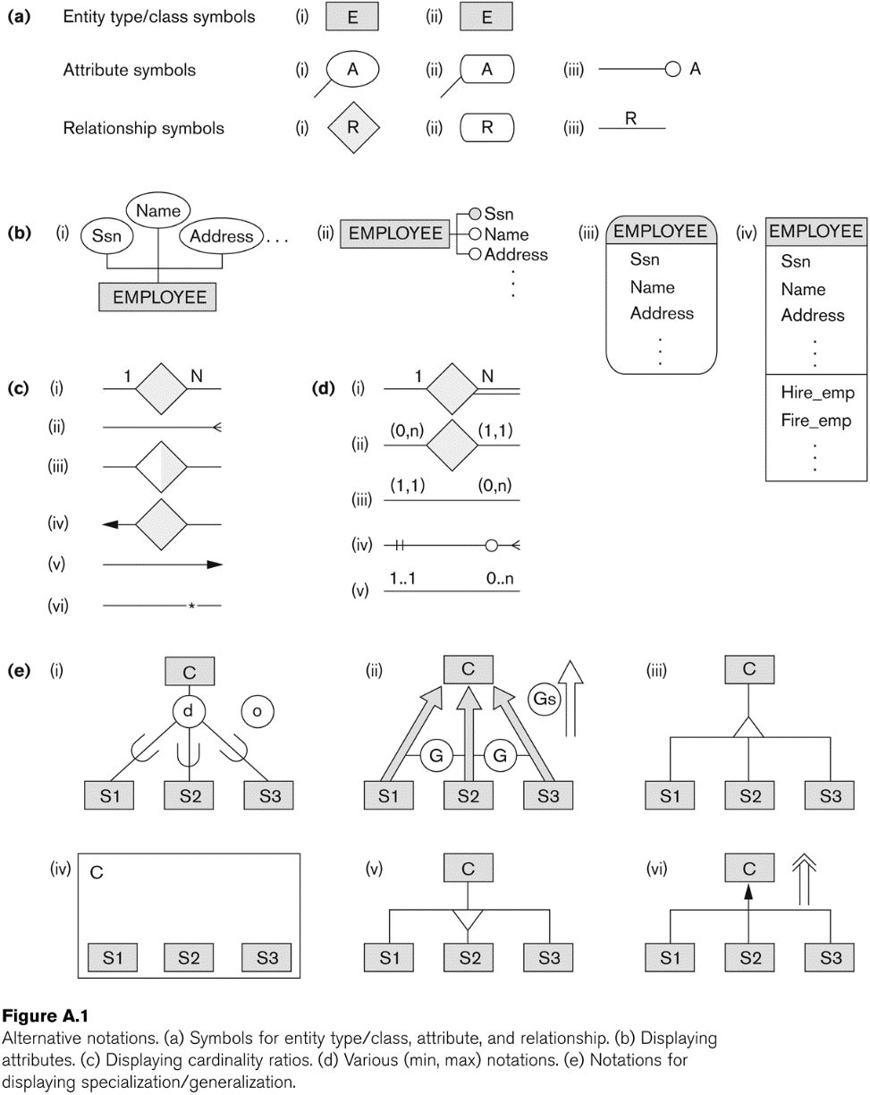
Other alternative diagrammatic notations

Slide 62
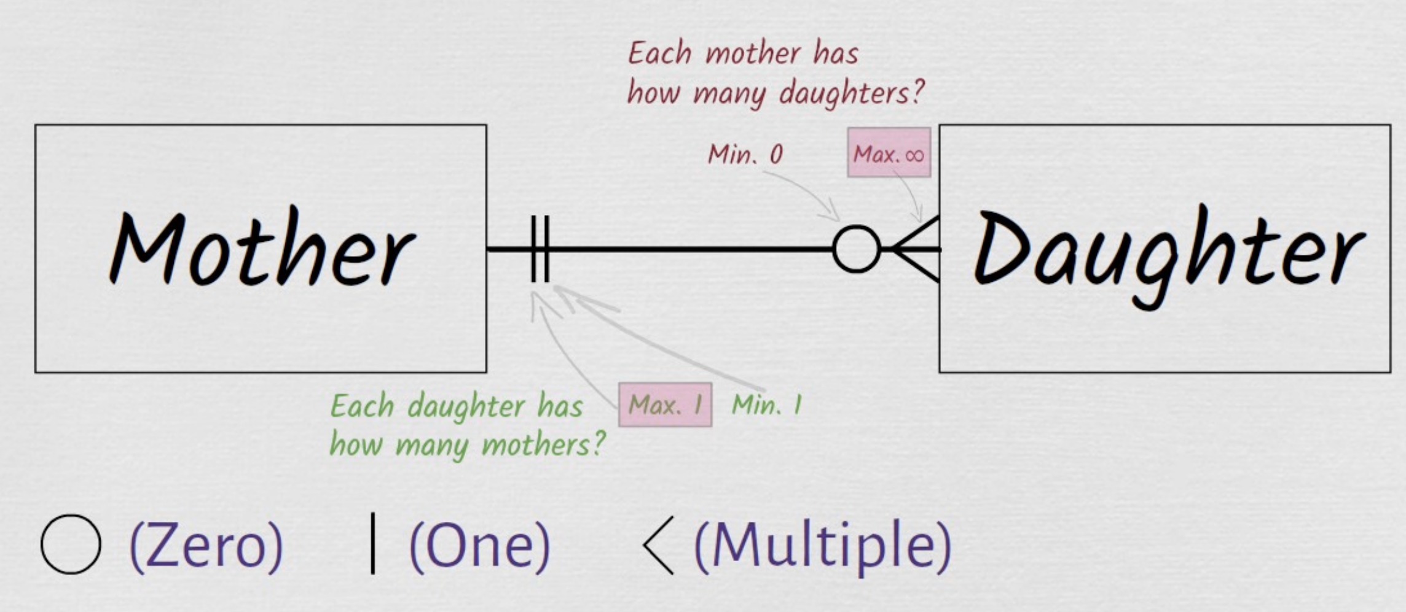
Crow’ Foot Notation

Slide 63
Relationships of Higher Degree
Relationship types of degree 2 are called binary
Relationship types of degree 3 are called ternary and of degree n are called n-ary
In general, an n-ary relationship is not equivalent to n binary relationships
Constraints are harder to specify for higher-degree relationships (n > 2) than for binary relationships

Slide 64
Discussion of n-ary relationships (n > 2)
In general, 3 binary relationships can represent different information than a single ternary relationship (see Figure 3.17a and b on next slide)
If needed, the binary and n-ary relationships can all be included in the schema design (see Figure 3.17a and b, where all relationships convey different meanings)
In some cases, a ternary relationship can be represented as a weak entity if the data model allows a weak entity type to have multiple identifying relationships (and hence multiple owner entity types) (see Figure 3.17c)

Slide 65
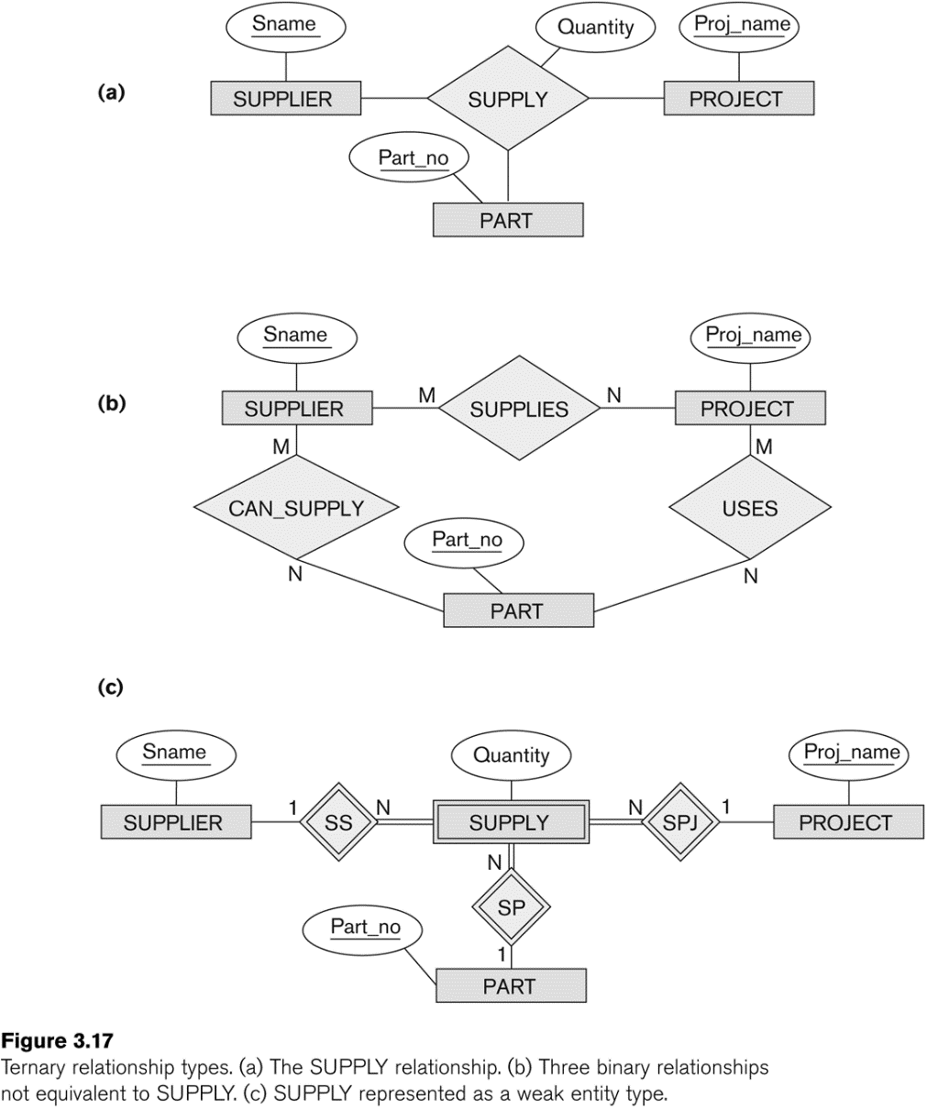
Example of a ternary relationship

Slide 66
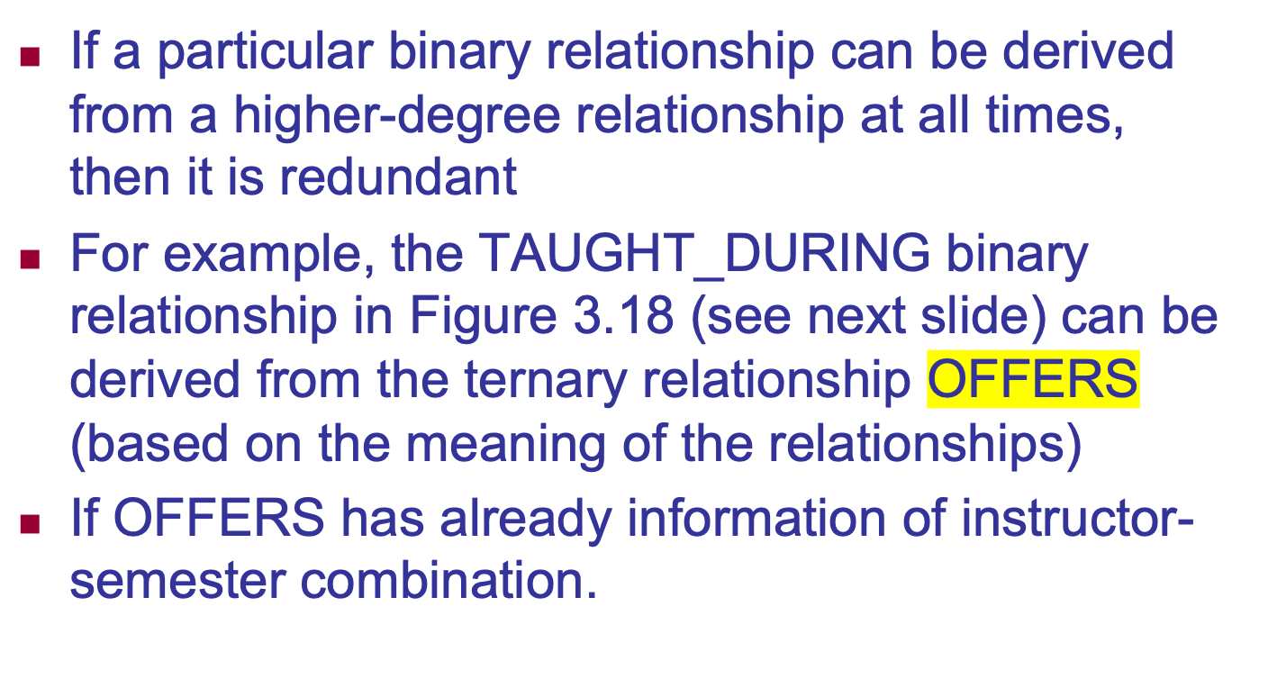
Discussion of n-ary relationships (n > 2)

Slide 67
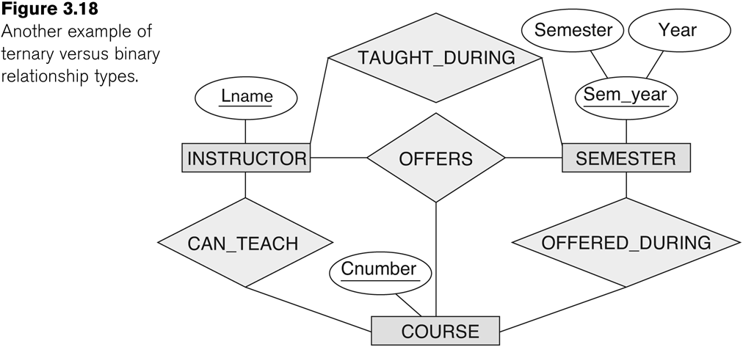
Another example of a ternary relationship

Slide 68
Ternary (or n-ary) identifying relationship
Imagine a database that keeps track of candidates interviewing for jobs at various companies
Employment agency database
In the requirements, a candidate can have multiple interviews with the same company (for example, with different company departments or on separate dates)
But a job offer is made based on one of the interviews

Slide 69
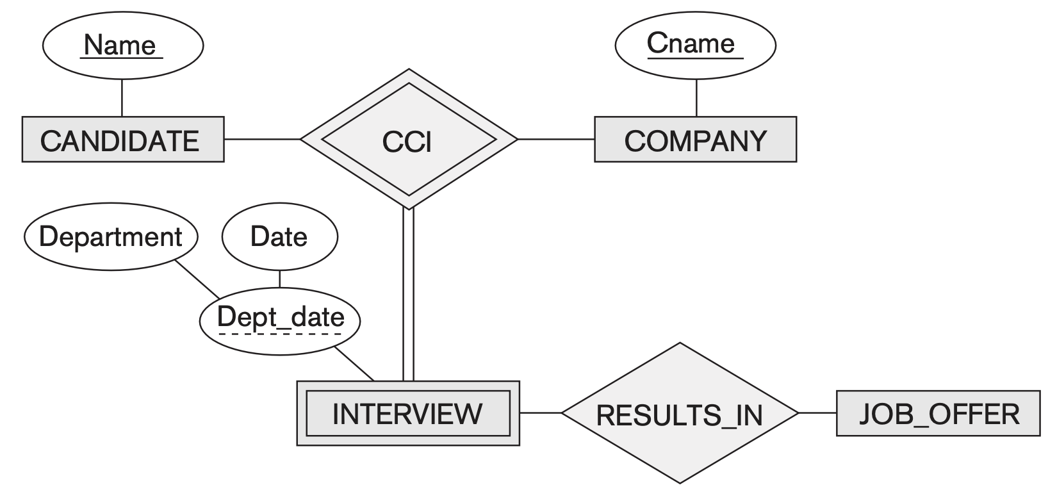
Ternary (or n-ary) identifying relationship
Company Candidate Interview

Slide 70
Displaying constraints on higher-degree relationships
The (min, max) constraints can be displayed on the edges – however, they do not fully describe the constraints
Displaying a 1, M, or N indicates additional constraints
An M or N indicates no constraint
A 1 indicates that an entity can participate in at most one relationship instance that has a particular combination of the other participating entities
In general, both (min, max) and 1, M, or N are needed to describe fully the constraints
Overall, the constraint specification is difficult and possibly ambiguous when we consider relationships of a degree higher than two.

Slide 71
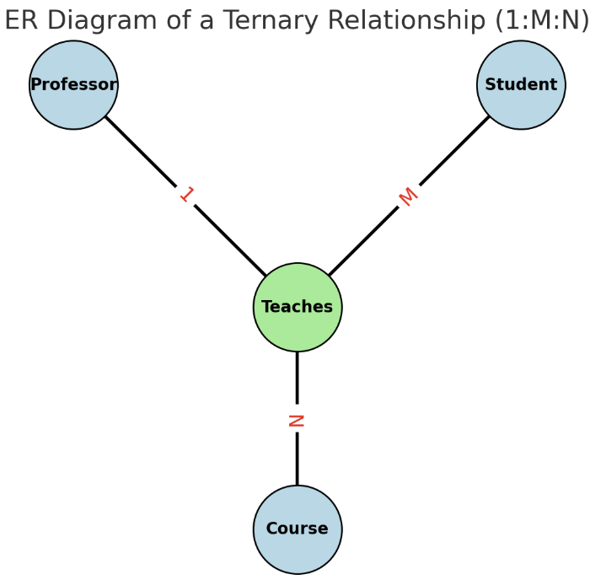
Ternary Relationship (1:M:N) cardinality ratio
Professor (1) → Each Course is taught by one Professor.
Student (M) → A Professor teaches many Students.
Course (N) → A Student can enroll in many Courses.
Consider cardinalities pairwise like a specific Course-Student combination can only get one professor.

Slide 72
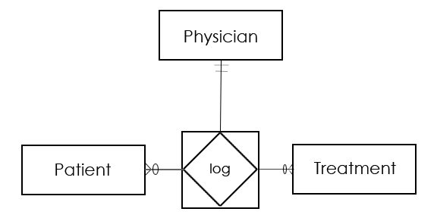
Anorther Ternary Relationship Example
1 Physician with 1 specific Patient can log M Treatments
1 Physician logs 1 specific Treatment for N Patients
1 Patient is logged 1 specific Treatment by 1 Physician
So, the ternary relationship log is an M-N-1 relationship between the participating entities Treatment-Patient-Physician (in this order).

Slide 73
Another Example: A UNIVERSITY Database
To keep track of the enrollments in classes and student grades, another database is to be designed.
It keeps track of the COLLEGEs, DEPARTMENTs within each college, the COURSEs offered by departments, and SECTIONs of courses, INSTRUCTORs who teach the sections etc.
These entity types and the relationships among these entity types are shown on the next slide in Figure 3.20.

Slide 74
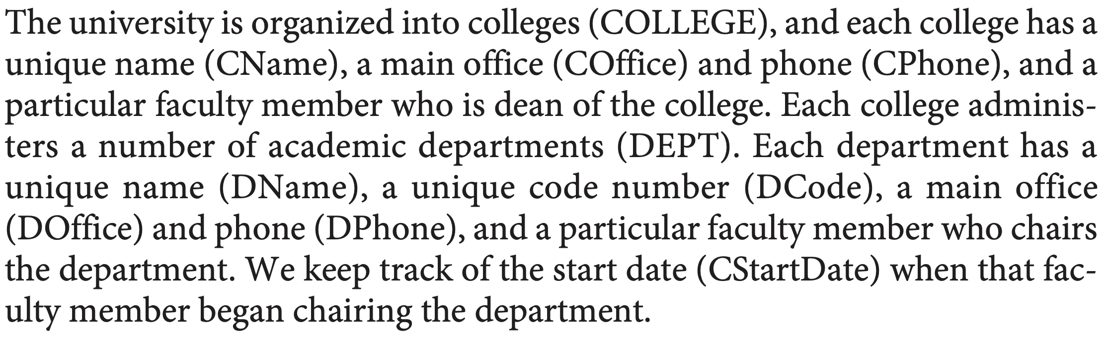
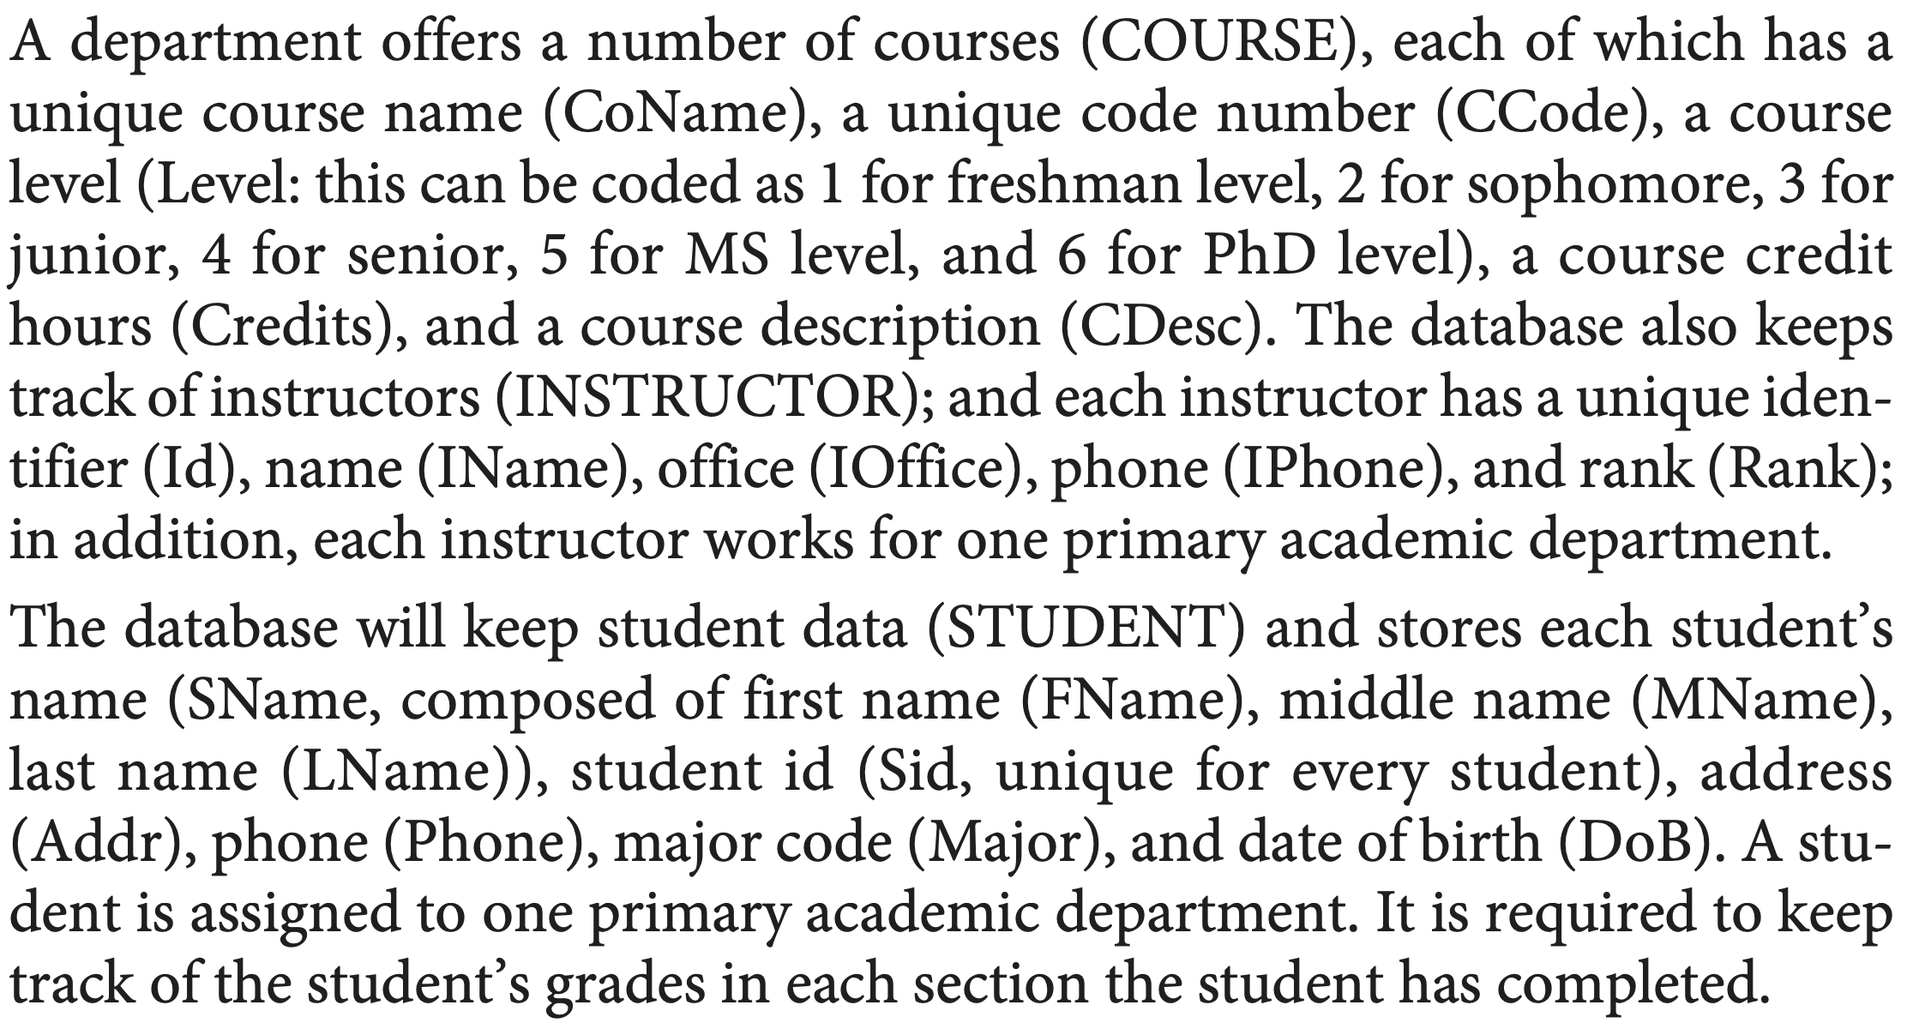

Slide 75
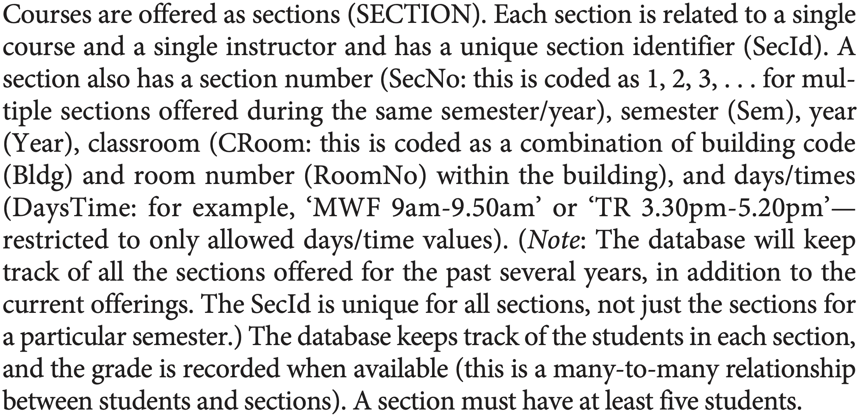

Slide 76
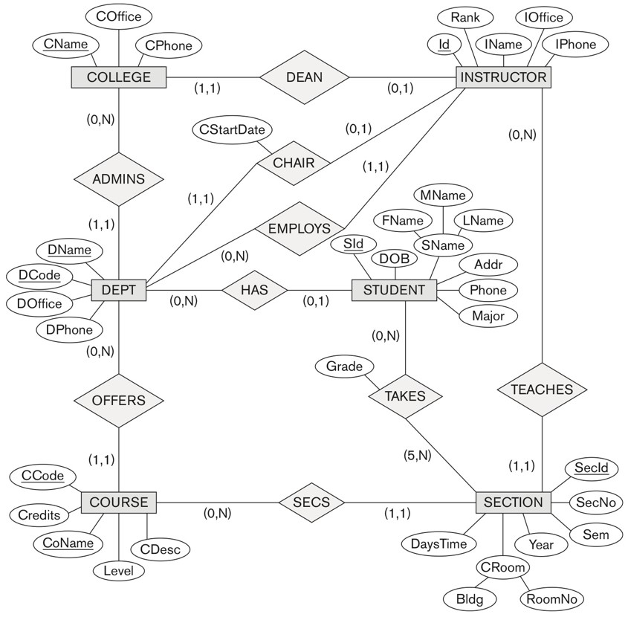


Slide 77
Chapter Summary
ER Model Concepts: Entities, attributes, relationships
Constraints in the ER model
Using ER in step-by-step mode conceptual schema design for the COMPANY database
ER Diagrams - Notation
Alternative Notations – UML class diagrams, others
Binary Relationship types and those of higher degree.

Slide 78
Data Modeling Tools (Additional Material )
A number of popular tools that cover conceptual modeling and mapping into relational schema design.
Examples: ERWin, S- Designer (Enterprise Application Suite), ER- Studio, etc.
POSITIVES:
Serves as documentation of application requirements, easy user interface - mostly graphics editor support
NEGATIVES:
Most tools lack a proper distinct notation for relationships with relationship attributes
Mostly represent a relational design in a diagrammatic form rather than a conceptual ER-based design

Slide 79
Some of the Automated Database Design Tools (Note: Not all may be on the market now)
COMPANY | TOOL | FUNCTIONALITY
Embarcadero Technologies | ER Studio | Database Modeling in ER and IDEF1X
 | DB Artisan | Database administration, space and security management
Oracle | Developer 2000/Designer 2000 | Database modeling, application development
Popkin Software | System Architect 2001 | Data modeling, object modeling, process modeling, structured analysis/design
Platinum (Computer Associates) | Enterprise Modeling Suite: Erwin, BPWin, Paradigm Plus | Data, process, and business component modeling
Persistence Inc. | Pwertier | Mapping from O-O to relational model
Rational (IBM) | Rational Rose | UML Modeling & application generation in C++/JAVA
Resolution Ltd. | Xcase | Conceptual modeling up to code maintenance
Sybase | Enterprise Application Suite | Data modeling, business logic modeling
Visio | Visio Enterprise | Data modeling, design/reengineering Visual Basic/C++

Slide 80
Extended Entity-Relationship (EER) Model (in the next chapter)
The entity relationship model in its original form did not support the specialization and generalization abstractions
Next chapter illustrates how the ER model can be extended with
Type-subtype and set-subset relationships
Specialization/Generalization Hierarchies
Notation to display them in EER diagrams

